Slide 1
LESSON 14

Slide 2
Overview
of
Previous Lesson(s)

Slide 3

Over View
Algorithm for converting RE to an NFA .
The algorithm is syntax- directed, it works recursively up the parse tree for the regular expression.

Slide 4
Over View..
Method:
Begin by parsing r into its constituent sub-expressions.
Basis rule if for handling sub-expressions with no operators.
Inductive rules are for constructing NFA's for the immediate sub expressions of a given expression.

Slide 5


Over View...
Basis Step:
For expression ε construct the NFA
For any sub-expression a in Σ construct the NFA

Slide 6
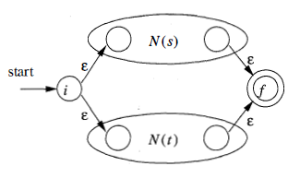
Over View...
Induction Step:
Suppose N(s) and N(t) are NFA's for regular expressions s and t, respectively.
If r = s|t. Then N(r) , the NFA for r, should be constructed as

Slide 7

Over View...
If r = st , Then N(r) , the NFA for r, should be constructed as
N(r) accepts L(s)L(t) , which is the same as L(r) .

Slide 8
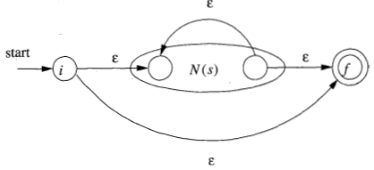
Over View...
If r = s* , Then N(r) , the NFA for r, should be constructed as
For r = (s) , L(r) = L(s) and we can use the NFA N(s) as N(r).

Slide 9
Over View...
Algorithms that have been used to implement and optimize pattern matchers constructed from regular expressions.
The first algorithm is useful in a Lex compiler, because it constructs a DFA directly from a regular expression, without constructing an intermediate NFA.
The resulting DFA also may have fewer states than the DFA constructed via an NFA.

Slide 10
Over View...
The second algorithm minimizes the number of states of any DFA, by combining states that have the same future behavior.
The algorithm itself is quite efficient, running in time O(n log n), where n is the number of states of the DFA.
The third algorithm produces more compact representations of transition tables than the standard, two-dimensional table.

Slide 11
Over View...
A state of an NFA can be declared as important if it has a non-ɛ out-transition.
NFA has only one accepting state, but this state, having no out-transitions, is not an important state.
By concatenating a unique right endmarker # to a regular expression r, we give the accepting state for r a transition on #, making it an important state of the NFA for (r) #.
The important states of the NFA correspond directly to the positions in the regular expression that hold symbols of the alphabet.

Slide 12
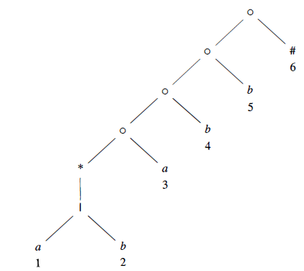
Over View...
Syntax tree for (a|b)*abb#

Slide 13
TODAY’S LESSON

Slide 14
Contents
Optimization of DFA-Based Pattern Matchers
Important States of an NFA
Functions Computed From the Syntax Tree
Computing nullable, firstpos, and lastpos
Computing followups
Converting a RE Directly to DFA
Minimizing the Number of States of DFA
Trading Time for Space in DFA Simulation
Two dimensional Table
Terminologies

Slide 15
Functions Computed From the Syntax Tree
To construct a DFA directly from a regular expression, we construct its syntax tree and then compute four functions: nullable, firstpos, lastpos, and followpos.
nullable(n) is true for a syntax-tree node n if and only if the sub-expression represented by n has ɛ in its language.
That is, the sub-expression can be "made null" or the empty string, even though there may be other strings it can represent as well.

Slide 16
Functions Computed From the Syntax Tree..
firstpos(n) is the set of positions in the sub-tree rooted at n that correspond to the first symbol of at least one string in the language of the sub-expression rooted at n.
lastpos(n) is the set of positions in the sub-tree rooted at n that correspond to the last symbol of at least one string in the language of the sub expression rooted at n.

Slide 17
Functions Computed From the Syntax Tree...
followpos(p) , for a position p, is the set of positions q in the entire syntax tree such that there is some string x = a₁ a₂ . . . a_{n} in L((r)#) such that for some i, there is a way to explain the membership of x in L((r)#) by matching a_{i} to position p of the syntax tree and a_{i+1} to position q

Slide 18
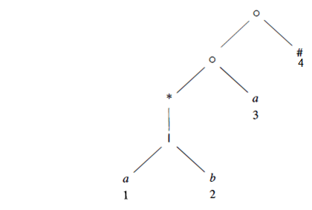
Functions Computed From the Syntax Tree…
Ex. Consider the cat-node n that corresponds to (a|b)*a
nullable(n) is false:
It generates all strings of a's and b's
ending in an a & it does not generate ɛ .

Slide 19
Functions Computed From the Syntax Tree…
firstpos(n) = {1,2,3}
For string like aa the first position corresponds to position 1
For string like ba the first position corresponds to position 2
For string of only a the first position corresponds to position 3

Slide 20
Functions Computed From the Syntax Tree…
lastpos(n) = {3}
For now matter what string is, the last position will always be 3 because of ending node a
followpos are trickier to computer.
So will see a proper mechanism.

Slide 21
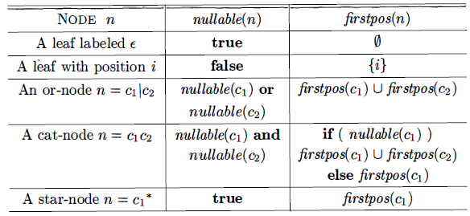
Computing nullable, firstpos, and lastpos
nullable, firstpos, and lastpos can be computed by a straight forward recursion on the height of the tree.

Slide 22
Computing nullable, firstpos, and lastpos..
The rules for lastpos are essentially the same as for firstpos, but the roles of children C₁ and C₂ must be swapped in the rule for a cat-node.

Slide 23
Computing nullable, firstpos, and lastpos...
Ex.
nullable(n):
None of the leaves of are nullable, because they each correspond to non-ɛ operands.
The or-node is not nullable, because neither of its children is.
The star-node is nullable, because every star-node is nullable.
The cat-nodes, having at least one non null able child, is not nullable.

Slide 24
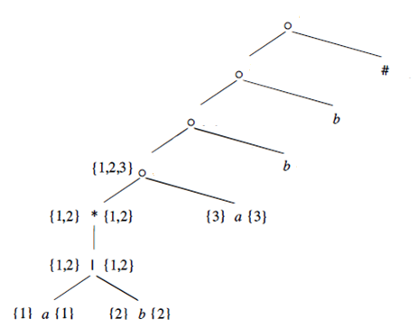
Computing nullable, firstpos, and lastpos...
Computation of lastpos of 1st cat-node appeared in our tree.
Rule: if (nullable(C₂))
firstpos(C₂) U firstpos(C₁)
else firstpos(C₂)

Slide 25
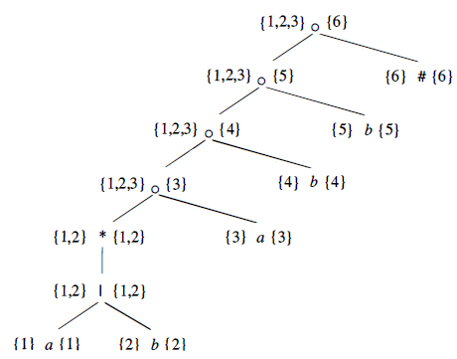
Computing nullable, firstpos, and lastpos...
The computation of firstpos and lastpos for each of the nodes provides the following result:
firstpos(n) to the left of node n.
lastpos(n) to the right of node n.

Slide 26
Computing followpos
Two ways that a position of a regular expression can be made to follow another.
If n is a cat-node with left child C₁ and right child C₂ then for every position i in lastpos(C₁) , all positions in firstpos(C₂) are in
followpos(i).
If n is a star-node, and i is a position in lastpos(n) , then all positions in firstpos(n) are in followpos(i).

Slide 27
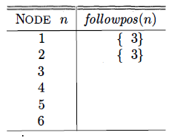
Computing followpos..
Ex.
Starting from lowest cat node
lastpos(c₁) = {1,2}
firstpos(c₂) = {3}
So, applying Rule 1 we got

Slide 28
Computing followpos...
Computation of followpos for next cat node

Slide 29
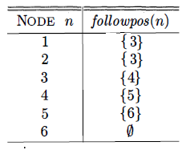
Computing followpos...
followpos of all cat node

Slide 30
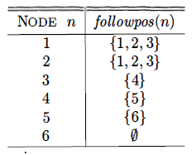
Computing followpos...
followup for star node n
lastpos(n) = {1,2}
firstpos(n) = {1,2}
ȋ = 1,2
So, applying Rule 2 we got

Slide 31
Computing followpos…
followpos can be represented by creating a directed graph with a node for each position and an arc from position i to position j if and only if j is in followpos(i)

Slide 32
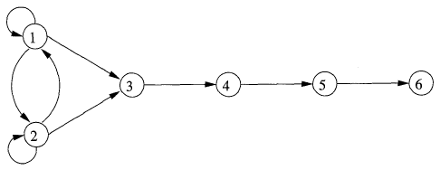
Computing followpos…
followpos can be represented by creating a directed graph with a node for each position and an arc from position i to position j if and only if j is in followpos(i)

Slide 33
Converting RE directly to DFA
INPUT: A regular expression r
OUTPUT: A DFA D that recognizes L(r)
METHOD:
Construct a syntax tree T from the augmented regular expression (r) #.
Compute nullable, firstpos, lastpos, and followpos for T.
Construct Dstates, the set of states of DFA D , and Dtran, the transition function for D (Procedure). The states of D are sets of positions in T.
Initially, each state is "unmarked," and a state becomes "marked" just before we consider its out-transitions. The start state of D is firstpos(n₀) , where node n₀ is the root of T. The accepting states are those containing the position for the endmarker symbol #.

Slide 34
Converting RE directly to DFA..
Ex. DFA for the regular expression r = (a|b)*abb
Putting together all previous steps:
Augmented Syntax Tree r = (a|b)*abb#
Nullable is true for only star node
firstpos & lastpos are showed in tree
followpos are:

Slide 35
Converting RE directly to DFA…
Start state of D = A = firstpos(rootnode) = {1,2,3}
Now we have to compute Dtran[A, a] & Dtran[A, b]
Among the positions of A, 1 and 3 corresponds to a, while 2 corresponds to b.
Dtran[A, a] = followpos(1) U followpos(3) = { l , 2, 3, 4}
Dtran[A, b] = followpos(2) = {1, 2, 3}
State A is similar, and does not have to be added to Dstates.
B = {I, 2, 3, 4 } , is new, so we add it to Dstates.
Proceed to compute its transitions..

Slide 36
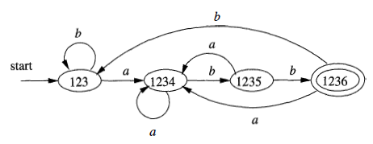
Converting RE directly to DFA…
The complete DFA is

Slide 37
Thank You

